Slide 1
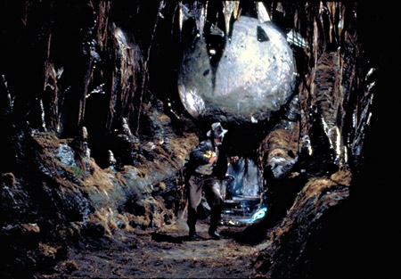
Cryptography in a
Post-Quantum World
http://indianajones.wikia.com/wiki/Raiders_of_the_Lost_Ark
Lily Chen, Dustin Moody
National Institute of Standards and Technology (NIST)

Slide 2
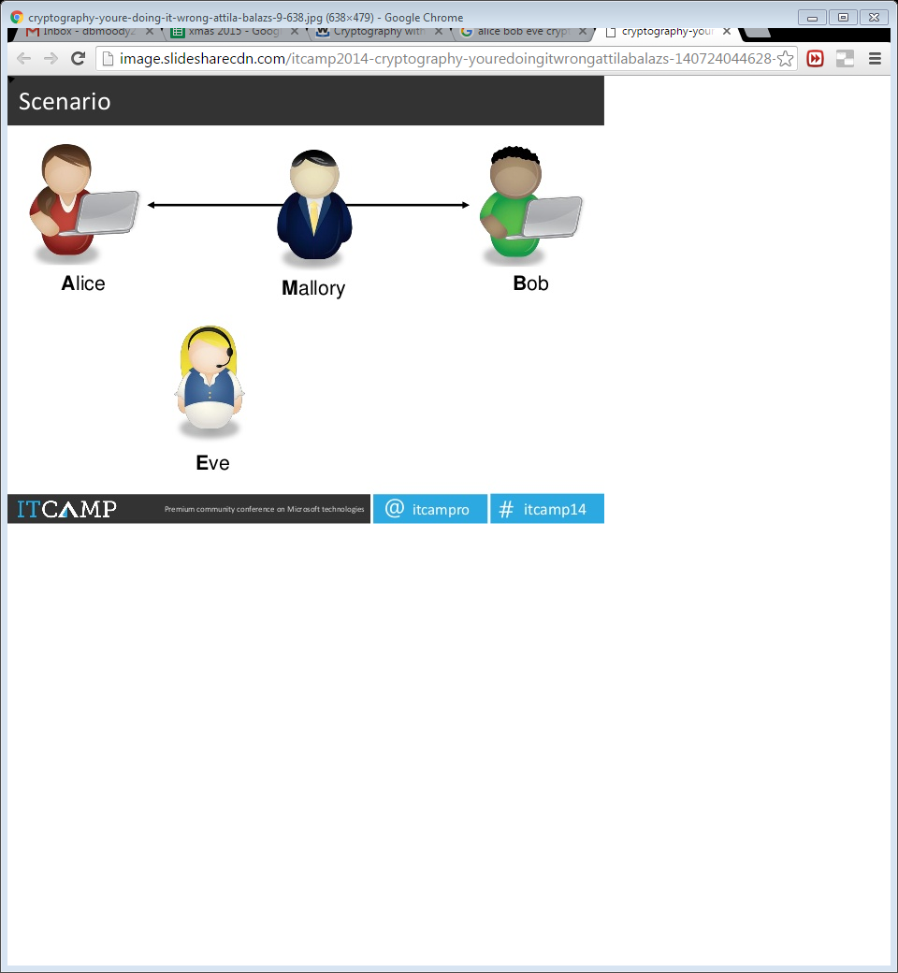
Cryptography
Alice and Bob want to communicate
  Beware of Eve
Symmetric-key crypto
  Alice and Bob have a shared key
  Example: AES (encryption)
Public-key crypto
  Alice has never met Bob, but wants to send him a message
  Example: RSA (encryption and signatures)
Notes:
How gets used: PKC is slower. Used to establish key with Bob, then switch to symmetric key.

Slide 3
Classical vs Quantum Computers
The security of crypto relies on intractability of certain problems to modern computers
  Example: RSA and factoring
Quantum computers
  Exploit quantum mechanics to process information
  Use quantum bits = “qubits” instead of 0’s and 1’s
  Superposition – ability of quantum system to be in multiples states at the same time
  Potential to vastly increase computational power beyond classical computing limit
Notes:
Quantum mechanics = behavior of small objects: atoms, electrons, photons
Superposition – allows for doing multiple computations at same time

Slide 4
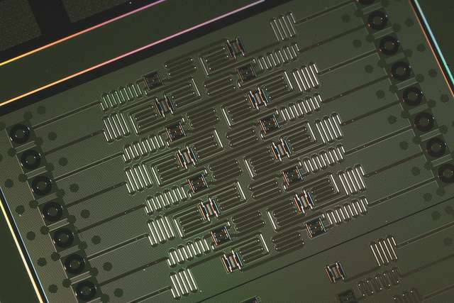
Quantum Computers
Difficulties
  When a measurement is made on quantum system, superposition collapses
  Quantum states are very fragile and must be extremely well isolated
  Intersection of many developing fields: superconductors, nanotechnology, quantum electronics, etc…
1998 – 2 qubits
2000 – 4, 5, and then 7 qubits
2006 – 12 qubits
2011 – 14 qubits
2017 – 20, 49 qubits ?? (Google)
Measuring qubits is not best metric
IBM’s 5 qubit and 16 qubit processors
Notes:
Entanglement – strong correlation between two quantum particles
Claims of higher qubit computations, but not
IBM making 5-qubit cloud computer available

Slide 5
Threshold Theorem
If error per quantum computation can be brought below (roughly) 0.5%, arbitrarily long quantum computations can be performed by correcting errors as you go
Theorists improve error correction schemes to tolerate higher error rates
Experimentalists achieve lower error rates
Threshold
Theorems
Experimental
Error Rates
0.0001%
(1997)
0.5%
(2015)
5%
(1995)

Slide 6
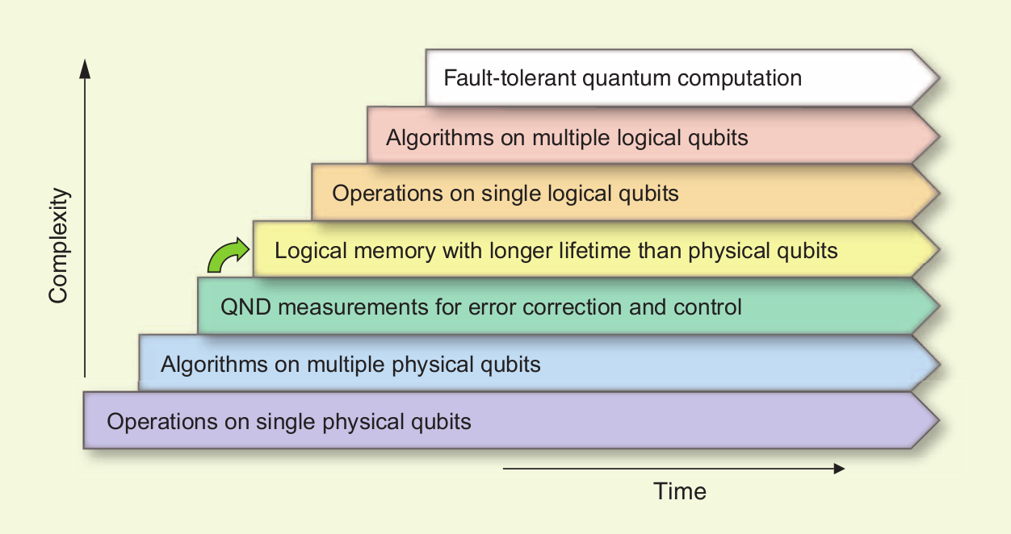
Quantum Computing Progress
A lot of progress, but still a long way to go
[Image credit: M. Devoret and R. Schoelkopf]
Notes:
QND is quantum non demolition
Chart from some Yale scientists

Slide 7
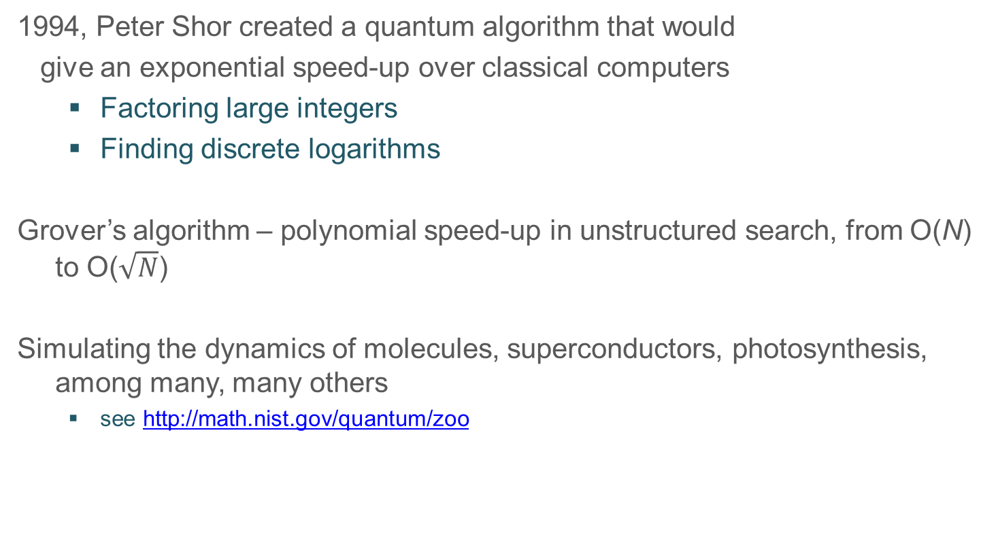
Quantum Algorithms
1994, Peter Shor created a quantum algorithm that would
give an exponential speed-up over classical computers
  Factoring large integers
  Finding discrete logarithms
Grover’s algorithm – polynomial speed-up in unstructured search, from O(N) to O($\sqrt{N}$)
Simulating the dynamics of molecules, superconductors, photosynthesis, among many, many others
  see http://math.nist.gov/quantum/zoo

Slide 8
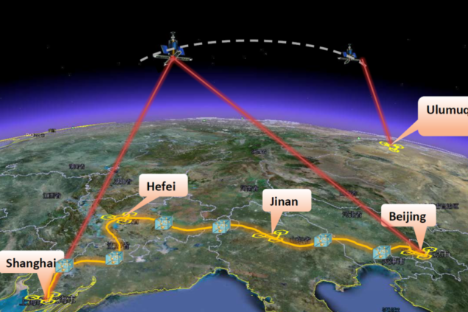
Quantum Cryptography
Quantum cryptography – using quantum computers to do cryptography
- Security is mostly based on physical assumptions (quantum mechanics)
Best example: Quantum Key Distribution (QKD)
Using quantum communication to establish a shared key between 2 parties
If an eavesdropper tries to learn any information, the observation causes the key exchange to have errors that can be detected
Security can be proven without imposing any restrictions on the abilities of the eavesdropper, which isn’t possible with classical crypto
Being developed commercially around the world

Slide 9
Limitations
Best example: Quantum Key Distribution (QKD)
- Using quantum communication to establish a shared key between 2 parties
- If an eavesdropper tries to learn any information, the observation causes the key exchange to have errors that can be detected
- Security can be proven without imposing any restrictions on the abilities of the eavesdropper, which isn’t possible with classical crypto
- Being developed commercially around the world
Drawbacks
- Specialized equipment (doesn’t run on classical computers)
- Not cheap
- Not easily scalable
The Cryptographic Technology Group at NIST is NOT focusing on QKD

Slide 10

NIST Cryptography Standards
Crypto standards
Post-Quantum Cryptography
Public key based
Symmetric key based
Guidelines
AES (FIPS 197 ) TDEA (800-67)
Hash usage/security (800-107)
Signature (FIPS 186)
Modes of operations (800 38A-38G)
Transition (800-131A)
Key establishment (800-56A/B/C)
Key generation (800-133)
SHA-1/2 (FIPS 180) and SHA-3 (FIPS 202)
Key management (800-57)
Tools
Randomized hash (800-106)
RNG (800-90A/B/C)
HMAC (FIPS 198)
KDF (800-108, 800-135)
SHA3 derived functions (parallel hashing, KMAC, etc. (800-185)

Slide 11
The Sky is Falling?
If a large-scale quantum computer could be built then….
Public key crypto:
  RSA
  ECDSA (and Elliptic Curve Cryptography)
  DSA (and Finite Field Cryptography)
  Diffie-Hellman key exchange
Symmetric key crypto:
  AES
  Triple DES
Hash functions:
  SHA-2 and SHA-3

Slide 12
The Sky is Falling?
If a large-scale quantum computer could be built then….
Public key crypto:
  RSA
  ECDSA (and Elliptic Curve Cryptography)
  DSA (and Finite Field Cryptography)
  Diffie-Hellman key exchange
Symmetric key crypto:
  AES
  Triple DES
Hash functions:
  SHA-2 and SHA-3

Slide 13
The Sky is Falling?
If a large-scale quantum computer could be built then….
Public key crypto:
  RSA
  ECDSA (and Elliptic Curve Cryptography)
  DSA (and Finite Field Cryptography)
  Diffie-Hellman key exchange
Symmetric key crypto:
  AES Need longer keys
  Triple DES Need longer keys
Hash functions:
  SHA-2 and SHA-3 Use longer output

Slide 14
PQC Standardization – Is it too early?
It has been a long debate among researchers and practitioners on whether it is too early to look into PQC standardization
When will a large-scale quantum computer be built?
- “There is a 1 in 7 chance that some fundamental public-key crypto will be broken by quantum by 2026, and a 1 in 2 chance of the same by 2031.”
– Dr. Michele Mosca, U. of Waterloo
Our experience tells that we need at least several years to developing and deploying PQC standards
Notes:
Could add Mariantoni’s estimate
There is skepticism

Slide 15
How soon do we need to worry?
How long does your information need to be secure (x years)
How long to re-tool existing infrastructure with quantum safe solution (y years)
How long until a large-scale quantum computer is built (z years)
Theorem (Mosca): If x + y > z, then worry
What do we do here??
y
x
z
secret keys revealed
time
Notes:
ECC took from it’s invention in 1985 to only now starting to be widely used in 2015. 30 years!
Even if we don’t know when (or even if it will ever happen)….it is a realistic threat so we need to prepare

Slide 16
NSA IAD Announcement August 2015
NSA's Information Assurance Directorate updated its list of Suite B cryptographic algorithms
  “IAD will initiate a transition to quantum resistant algorithms in the not too distant future. Based on experience in deploying Suite B, we have determined to start planning and communicating early about the upcoming transition to quantum resistant algorithms.”
Standardization is the first step towards the transition

Slide 17
Post-Quantum Cryptography (PQC)
Cryptosystems which run on classical computers, and are considered to be resistant to quantum attacks
PQC needs time to be ready for applications
  Efficiency
  Confidence – cryptanalysis
  Standardization
  Usability and interoperability
  (IKE, TLS, etc… use public key crypto)

Slide 18

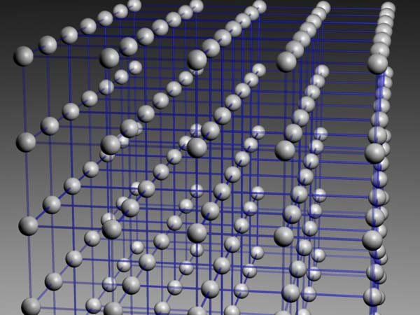
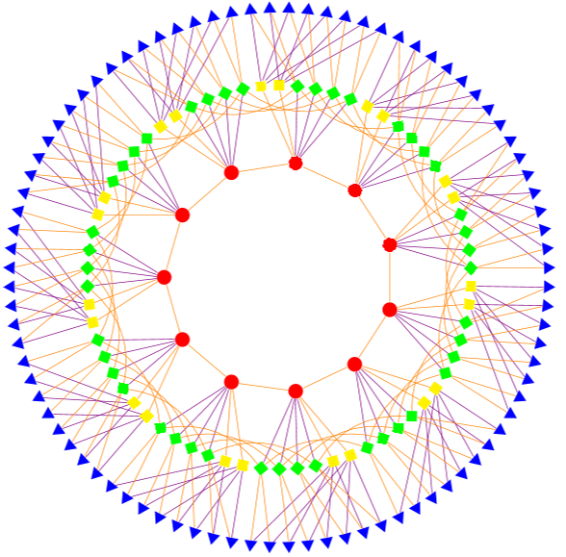
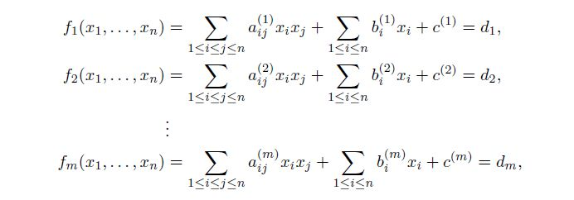
Possible Replacements
Lattice-based
Code-based
Multivariate
Others
  Hash-based signatures
  Isogeny-based signatures
  Etc….
All have their pros and cons

Slide 19

Practical Questions
Which are most important in practice?
  Public and private key sizes
  Key pair generation time
  Ciphertext size
  Encryption/Decryption speed
  Signature size
  Signature generation/verification time
Really, a lot more questions than answers
Notes:
How do you guard against a machine that hasn’t even been built yet?

Slide 20
Encryption Schemes
Algorithm | KeyGen Time (RSA sign=1) | Decrypt Time (RSA sign=1) | Encrypt Time (RSA sign=1) | Public Key Size (bits) | Private Key Size (bits) | Ciphertext Size (bits) | Time* Scaling | Key* Scaling
NTRUEncrypt | 10 | 0.1 | 0.1 | ~3000 | ~4000 | ~3000 | k² | k
McEliece | 5 | 1 | 0.02 | 651264 | 1098256 | 1660 | k² | k²
Quasi-Cyclic MDPC | 5 | 1 | 0.02 | 4801 | 9602 | 9602 | k² | k
RSA | 50 | 1 | 0.02 | 1024 | 1024 | 1024 | k⁶ | k³
DH | 0.5 | 0.5 | 0.5 | 1024 | 480 | 1024 | k⁴ | k³
ECC | 0.1 | 0.1 | 0.1 | 320 | 480 | 320 | k² | k
Disclaimer – these are rough estimates for comparison purposes only, not benchmarks. Numbers are for 80 bits of security.
* Time and key scaling ignore log k factors

Slide 21
Observations
For most of the potential PQC replacements, the times needed for encryption, decryption, signing, verification are acceptable
Some key sizes are significantly increased
  For most protocols, if the public keys do not need to be exchanged, it may not be a problem
Some ciphertext and signature sizes are not quite plausible
Key pair generation time for the encryption schemes is not bad at all
No easy “drop-in” replacements
Would be nice to have more benchmarks

Slide 22
PQC Standardization – A big decision to move forward
Considering the time to develop/deploy PQC standards and the backward secrecy required for information, it is the time to look into standardization
NIST is calling for quantum-resistant cryptographic algorithms for new public-key crypto standards
  Digital signatures
  Encryption/key-establishment
We see our role as managing a process of achieving community consensus in a transparent and timely manner
We do not expect to “pick a winner”
  Ideally, several algorithms will emerge as ‘good choices’
We may pick one (or more) for standardization
  Only algorithms publicly submitted considered

Slide 23

What we have done so far –
The first mile in a long journey
~ 2012 – NIST begins PQC project
  Research and build NIST team
April 2015 – 1st NIST PQC workshop
Aug 2015 – NSA statement
Feb 2016 – NIST Report on PQC (NISTIR 8105)
Feb 2016 – NIST preliminary announcement of standardization plan
Aug 2016 – Draft submission requirements and evaluation criteria released for public comments
Sep 2016 – Comment period ends
Dec 2016 – Announcement of finalized requirements and criteria(Federal Register Notice)
Nov 2017 – Deadline for submissions
Notes:
Mention NSA announcement

Slide 24

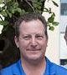
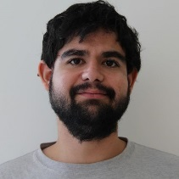
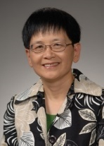
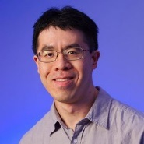

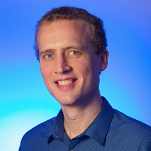
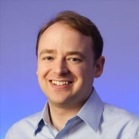
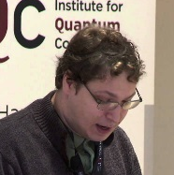

NIST PQC team – The most significant in the first mile
Consists of 10+ NIST researchers in crypto, quantum information, quantum algorithms
Hold bi-weekly seminars (internal and invited speakers)
Publish results at PQcrypto and other journals/conferences
Engage with research community (presentations and discussion forums)
Work with industry and standards organizations (ETSI, IETF, ISO/IEC SC27)
Reach government agencies for raising awareness of upcoming cryptography transition
Collaborate with QuiCS (Joint Center for Quantum Information and Computer Science) at the University of Maryland, as well as University of Waterloo
Notes:
Still want to expand

Slide 25
PQC Standardization Plan
NIST’s PQC Contest Standardization Plan
Timeline
Nov. 30, 2017 | Submission deadline
April 2018 | Workshop – Submitters’ presentations
3-5 years | Analysis phase - NIST reports on findings and more workshops/conferences
2 years later | Draft standards available for public comments
NIST will post “complete and proper” submissions
NIST PQC Standardization Conference (with PQCrypto, Apr 2018)
Initial phase of evaluation (12-18 months)
  Internal and public review
  No modifications allowed
Narrowed pool will undergo a second round (12-18 months)
  Second conference to be held
  Minor changes allowed
Possible third round of evaluation, if needed
NIST will release reports on progress and selection rationale
Notes:
Subject to change
We want community’s help as well

Slide 26
Complexities of PQC Standardization
Much broader scope – three crypto primitives
  Signatures, Encryption, Key agreement
Against both classical and quantum attacks
  Security strength assessment on specific parameter selections
Consider various theoretical security models and practical attacks
  Provably security vs. security against instantiation or implementation related security flaws and pitfalls
Multiple tradeoff factors
  Security, performance, key size, signature size, side-channel resistance countermeasures
Migrations into new and existing applications
  TLS, IKE, code signing, PKI infrastructure, and much more
Not exactly a competition – it is and it isn’t
Notes:
I like to highlight some complexities for PQC standardization. First, large scope, three crypto primitives, not like AES and SHA-3 competition. Second we need to consider both classical security and quantum security. I will further discuss quantum security late on in this presentations. Now we have established security models to prove the security, we also have many applications where the practical attacks can happen regardless the proof results. For each of the primitive, we have multiple tradeoff factors. For example, for hash based signature, stateful signature is shorter and stateless signature is larger. PQC is different from the first generation of PKC. At that time, we were trying to plug in and trying to make it work. Now we reply on those, replace them with new one will certainly not an easy task. We will talk challenges in a separate page. People ask us whether this is a competition, we have bene reluctant to call it a competition. Yes and No. Yes- Open and trans, public proposal and public analysis, NIST will make selection based on the synopsis. No – Not one algorithm, three primitives each may have more than one, no straight forward comparison, selection will be made in multiple rounds

Slide 27
Differences with AES/SHA-3 competitions
Post-quantum cryptography is more complicated than AES or SHA-3
  No silver bullet - each candidate has some disadvantage
  Not enough research on quantum algorithms to ensure confidence for some schemes
We do not expect to “pick a winner”
  Ideally, several algorithms will emerge as “good choices”
We may narrow our focus at some point
  This does not mean algorithms are “out”
Requirements/timeline could potentially change based on developments in the field
Notes:
We will devote substantial amount of resources, but will be less than for SHA-3

Slide 28

Minimal acceptability requirements
  Publicly disclosed and freely available during the process
    Signed statements, disclose patent info
  Implementable in wide range of platforms
  Provides at least one of: signature, encryption, or key exchange
  Theoretical and empirical evidence providing justification for security claims
  Concrete values for parameters meeting target security levels

Slide 29
The selection criteria
Secure against both classical and quantum attacks
Performance - measured on various "classical" platforms
Other properties
  Drop-in replacements - Compatibility with existing protocols and networks
  Perfect forward secrecy
  Resistance to side-channel attacks
  Simplicity and flexibility
  Misuse resistance, and
  More
Notes:
Are all the important other properties covered?

Slide 30
Security Analysis
Security definitions
  IND-CCA2 for encryption, EUF-CMA for signatures, CK best for key exchange?
  Used to judge whether an attack is relevant
Quantum/classical algorithm complexity
  Stability of best known attack complexity
  Precise security claim against quantum computation
  Parallelism?
Security proofs (not required but considered as support material)
Quality and quantity of prior cryptanalysis
Notes:
We may ask for a wider range of security levels than we ultimately decide to standardize
Indistinguishability under adaptive chosen ciphertext attack
EUF-CMA: Existential unforgeability under adaptive chosen message attacks
Canetti-Krawczyk

Slide 31
Quantum Security – How to assess it?
  Currently, NIST crypto standards specify parameters for classical security levels at 112, 128, 192, 256 bits
  For PQC standardization, need to specify concrete parameters with security estimates
    Led to the bits of quantum security requirements in the draft CFP
  No clear consensus on best way to measure quantum attacks
  Uncertainties
    The possibility that new quantum algorithms will be discovered, leading to new attacks
    The performance characteristics of future quantum computers, such as their cost, speed and memory size

Slide 32
Quantum Security Strength Categories
 | Security Description
I | At least as hard to break as AES128 (exhaustive key search)
II | At least as hard to break as SHA256 (collision search)
III | At least as hard to break as AES192 (exhaustive key search)
IV | At least as hard to break as SHA384 (collision search)
V | At least as hard to break as AES256 (exhaustive key search)
Computational resources should be measured using a variety of metrics
  Number of classical elementary operations, quantum circuit size, etc…
  Consider realistic limitations on circuit depth (e.g. 2⁴⁰ to 2⁸⁰ logical gates)
  May also consider expected relative cost of quantum and classical gates.
These are understood to be preliminary estimates
Notes:
Want submitters to primarily focus on levels 1,2,and 3
Also at least one parameter set for very high security (4 or 5)

Slide 33
Cost and Performance
Standardized post-quantum cryptography will be implemented in “classical” platforms
Ideally, implementable on wide variety of platforms and applications
May need to standardize more than one algorithm for each function to accommodate different application environments
from extremely processing constrained devices to limited communication bandwidth
Allowing parallel implementation for improving efficiency is certainly a plus
Preliminary conclusions: efficiency likely OK, but key sizes may pose a significant challenge
Notes:
Ideally, implementable on wide variety of platforms and applications

Slide 34
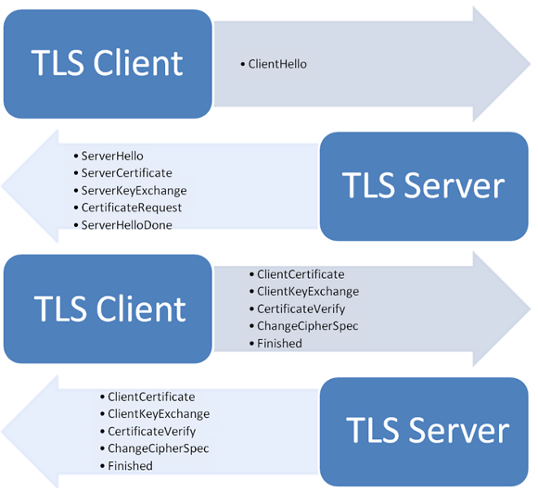
Drop-in Replacements
We’re looking for quantum-resistant drop-in replacements for existing applications, e.g. Internet Key Exchange (IKE) and Transport Layer Security (TLS)
  Key establishment
    Ideally, we’d like to have something to replace Diffie-Hellman key exchange
    Practically, we have to look into some schemes such as encryption with one-time public key, which are not quite drop-in replacements
  Signatures
    We’d like to have signatures with reasonable public key size, signature size, and fast signature verification
    Practically, we shall prepare to handle probably larger public keys, or/and larger signatures, (and to handle a stateful situation)
We need to be realistic about what we can get for the quantum-resistant counterpart for existing applications

Slide 35

Challenges
Uncertainties – Quantum Security
  The possibility that new quantum algorithms will be discovered, leading to new attacks
  The performance characteristics of future quantum computers, such as their cost, speed and memory size
Assess classical security
  Most of PQC schemes are relatively new
  It takes years to understand their classical security
We need to deal with new situations which we haven’t considered before, e.g.
  Decryption failure
  State management for hash based signatures
  Public-key encryption vs. key-exchange issues
    Public-key encryption IND-CCA2
    Ephemeral key exchange (no key-pair reuse, consider passive attacks, IND-CPA)
  Auxiliary functions/algorithms, e.g.
    Gaussian simulation
We have to move away from many things we have been used with existing schemes
Notes:
Quantum security is just one of the challenges. We need to handle many situations which are new to us. Here are just a few examples. The first is decryption failure. Some encryption algorithms, even you choose everything right, can have failed decryption. It may require a higher level protocol to handle how many decryption failures are allowed before halt. Some hash based signature needs to manage state. Each private key can only use once. The chosen ciphertext model does not apply to one-time key for key establishment. As we work hard on Random number generator for uniformly at random key generation, for some of the post-quantum schemes, we will be Gaussian simulation to generate one time random value.

Slide 36
Transition and Migration
NIST will update guidance when PQC standards are available
  SP 800-57 Part I specifies “classical” security strength levels 128, 192, and 256 bits are acceptable through 2030
Even with the upcoming PQC transition, still required to move away from weak algorithms/key sizes:
  Anything with “classical” security strength less than 112 bits should NOT be used anymore
  A “hybrid mode” has been proposed as a transition/migration step towards PQC cryptography
Such a mode combines a classical algorithm with a post-quantum one
Current FIPS 140 validation will only validate the NIST-approved (classical) component
The PQC standardization will only consider the post-quantum component
Notes:
SKIP

Slide 37
Interactions with Standards Organizations
We are aware that many international/industry standards organizations and expert groups are working on or planning to work on post quantum cryptography standards/recommendations
  IEEE P1363.3 has standardized some lattice-based schemes
  IETF is taking action in specifying stateful hash-based signatures
  ETSI released quantum-safe cryptography report
  EU expert groups PQCrypto and SafeCrypto made recommendations and released reports
  ISO/IEC JTC 1 SC27 has already had three six months study periods for quantum-resistant cryptography
NIST is interacting and collaborating with these organizations and groups
NIST plan to consider hash-based signatures as an early candidates for standardization, but probably just for specific applications like code signing

Slide 38

Summary
Quantum computers have HUGE potential
Post-quantum cryptography standardization is going to be a long journey
After the first mile, we have observed many complexities and challenges
Be prepared to transition to new algorithms in 10 years
We will continue to work with the community towards PQC standardization
See www.nist.gov/pqcrypto
Sign up for the pqc-forum for announcements and discussion
Notes:
Transition will not be painless

